Slide 1
Notes:
Hello everyone,

Slide 2





Glen R. Goodwin
@areinet
arei.net
github.com/arei
Notes:
I am Glen
And I'm here to tell you about
what may be the single greatest achievement
in Web Browser Technology.
Ever.
It's called ZephJS

Slide 3

Notes:
and it's going to change your life.
Well, maybe that's an exaggeration
but I do think you are going to find
ZephJS pretty cool.
However, before I can tell you about ZephJS,
I need to tell you about Web Components.

Slide 4

WEB COMPONENTS
Notes:
And I know that a few months ago,
We had Shane come in here
and talk about writing web components.
So instead of giving you all that again.
I'm going to summarize exactly what he said
In two short bullet points...
First
Web Components are
[SWITCH SLIDES]
AWESOME

Slide 5
AWESOME
Notes:
AWESOME
And Second
Glen is an incredibly handsome man.

Slide 6

Notes:
Not sure why he said that last bit
but it is absolutely what happened.
And that's the honest truth.
[pause]
Seriously though,

Slide 7
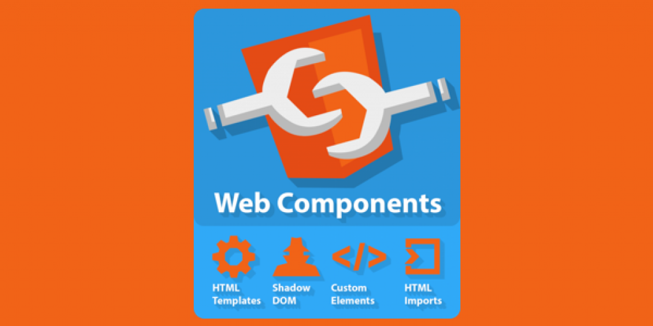
Notes:
Shane told us all about
how Web Components are
a collection of Browser API standards
that make writing
custom HTML tags possible.

Slide 8
<my-awesome-button>
</my-awesome-button>
Notes:
This means if I want to create <my-awesome-button>
it is possible with web components.
As Shane showed us
A Web Component,
uses the Custom Elements API

Slide 9
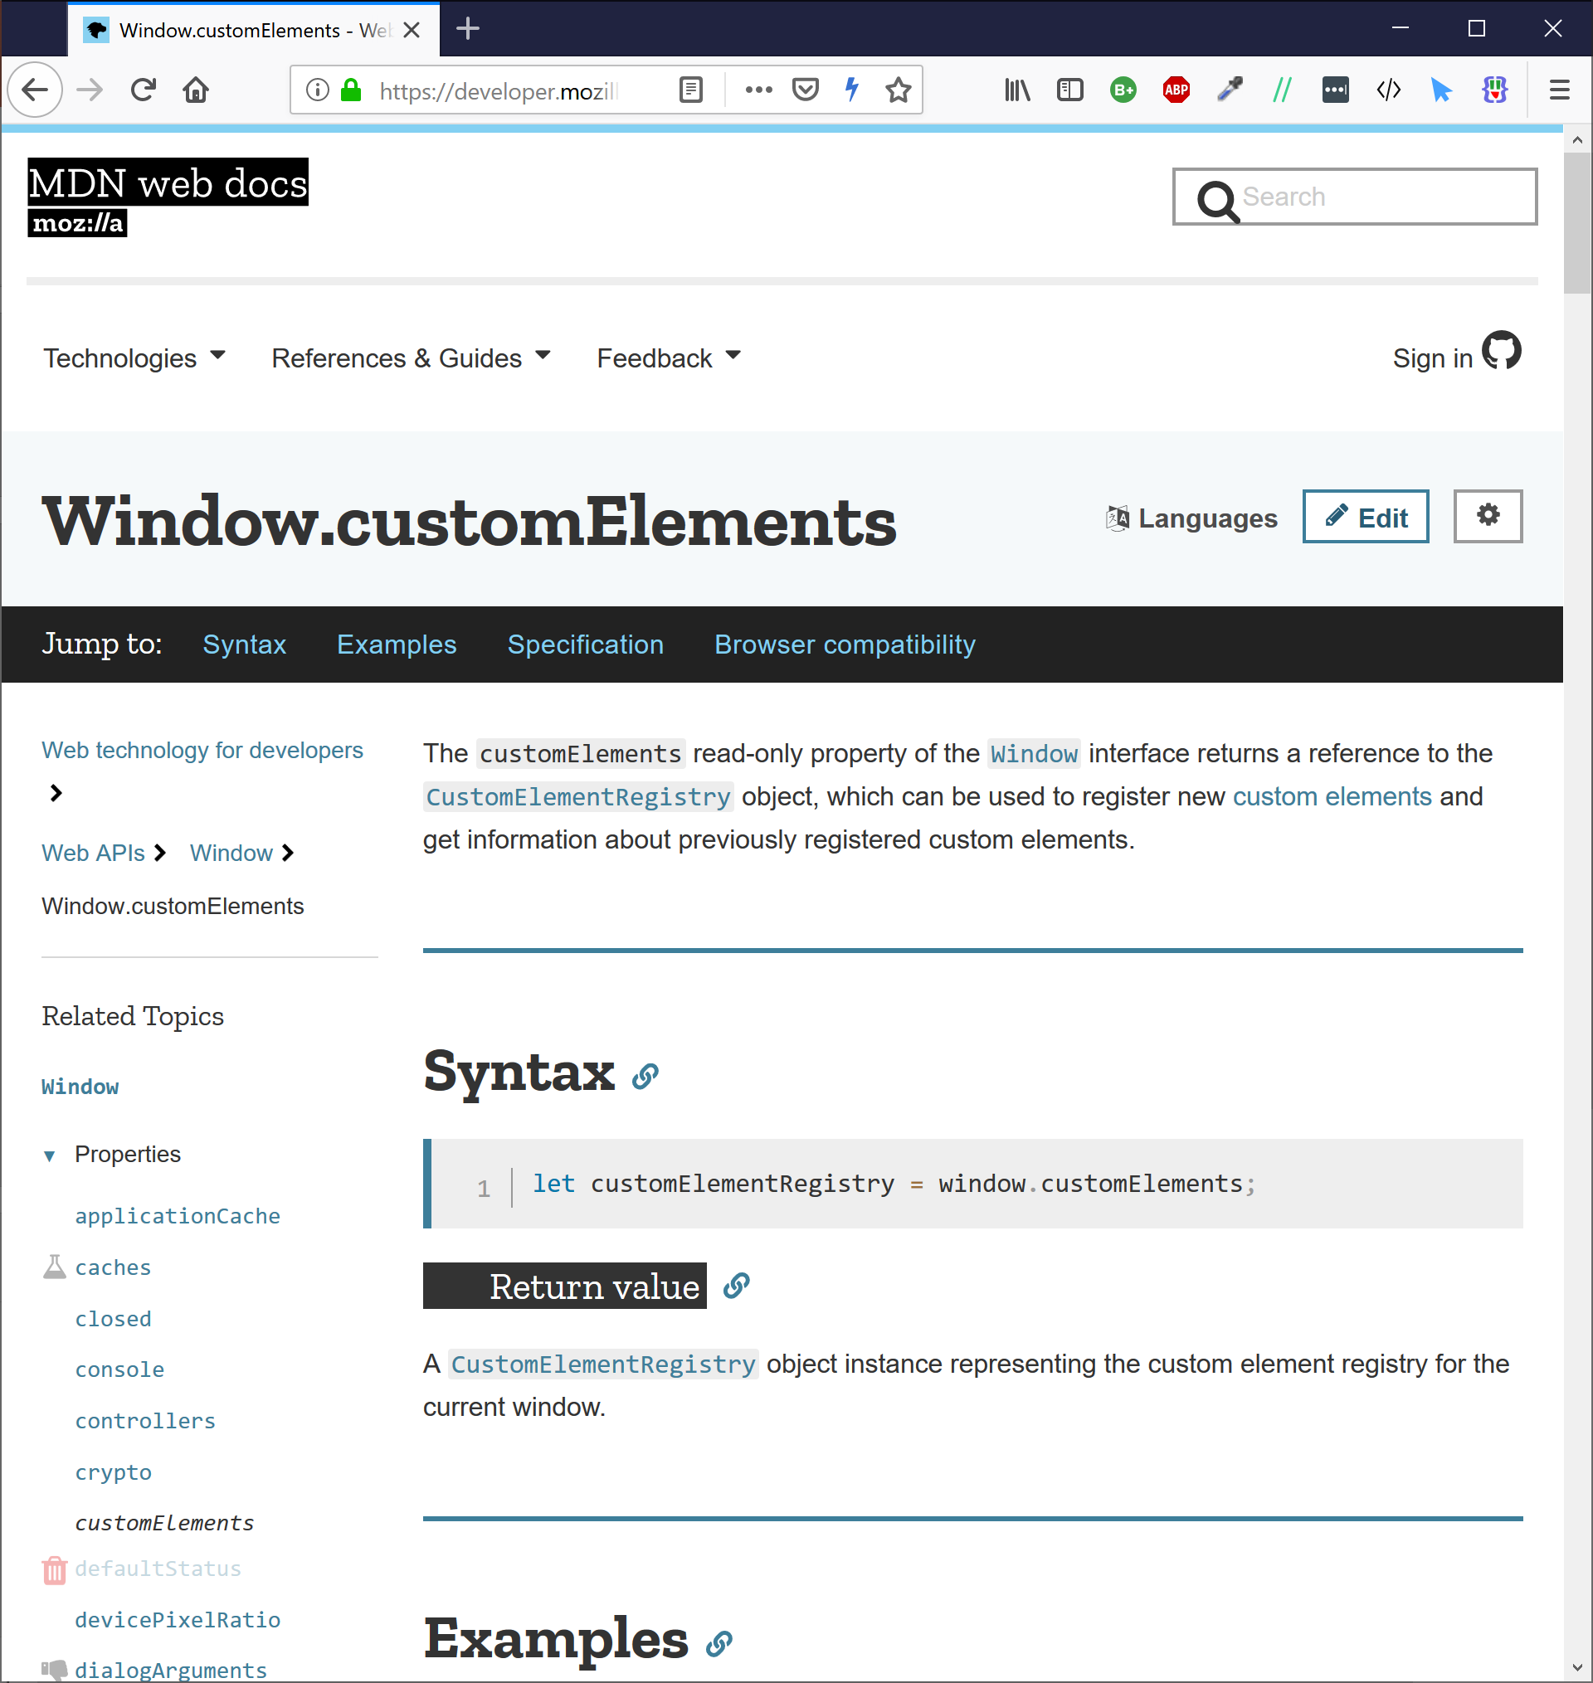
Notes:
to register a Component Class
That will be instantiated whenever
the given tag name is used.
For example, when we use
<my-awesome-button>
in our HTML
a new instance of
the registered component class
is created.
When that happens,
We attach a ShadowDOM root to it

Slide 10
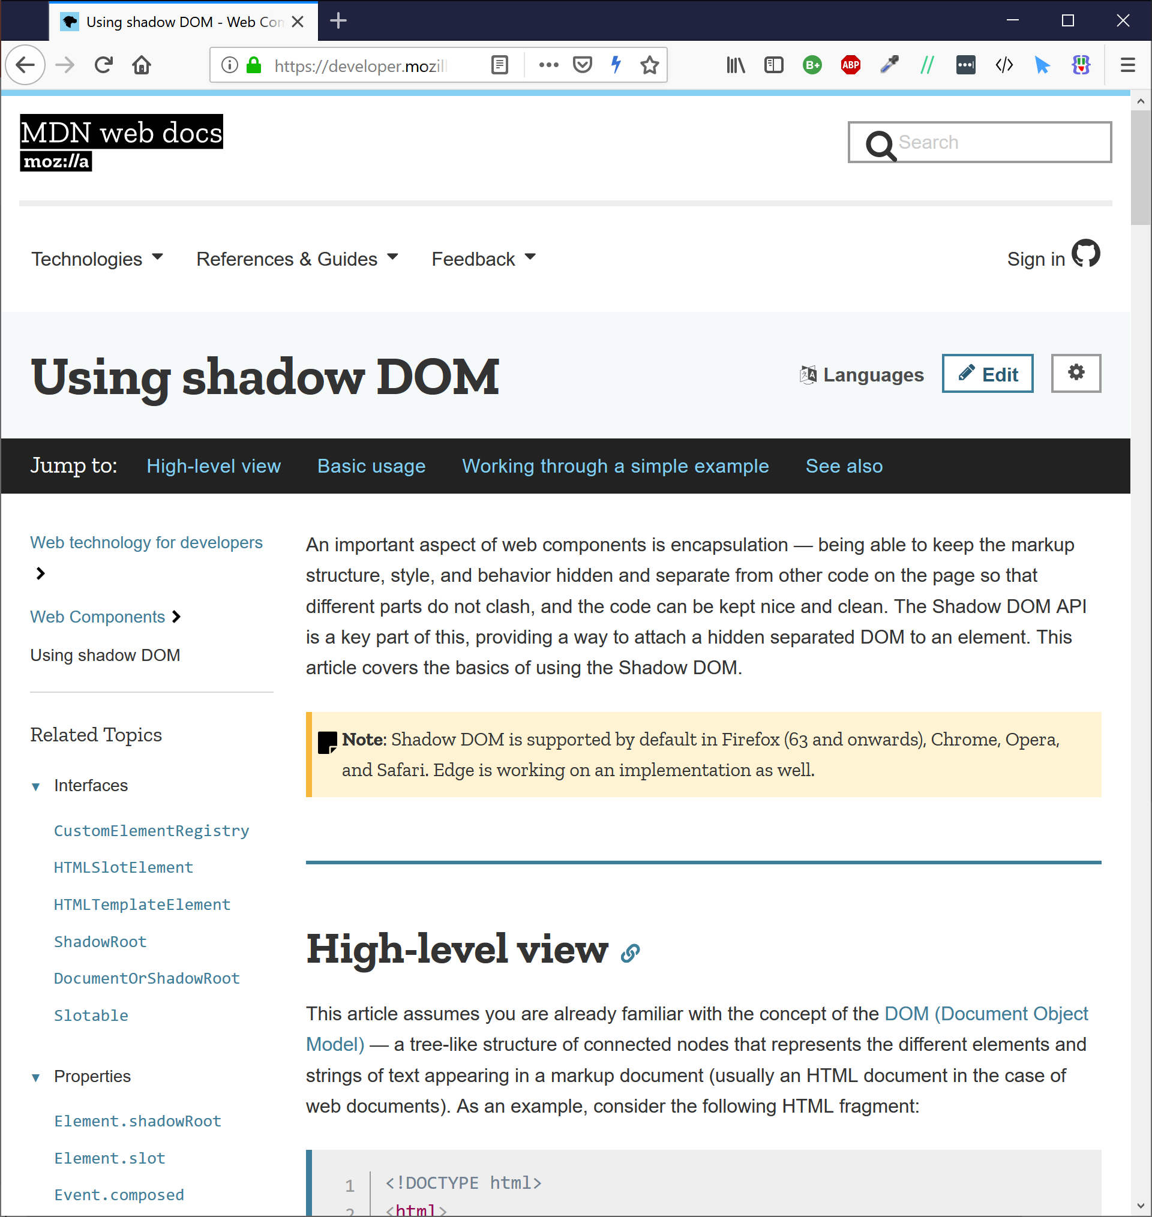
Notes:
which allows us to insert
content and style
into the element
that is isolated
from the rest of the DOM.
Meaning that HTML and CSS
associated with the web component
does not leak out of that component
into other parts of your page.
It is entirely isolated.
Altogether

Slide 11

<body>
<twtr-tweet-viewer style=“list”>
<twtr-tweet tweetId=“45yhbwrh356hw34t3w4gtqerf”>
Try ZephJS!
It’s the bomb!
</twtr-tweet>
<twtr-tweet tweetId=“wgreg24g5w4g25g3bt35545g”>
<twtr-tweet-media src=“images/4253452345234523452rgs”>
<twtr-tweet-media>
</twtr-tweet>
<twtr-tweet tweetId=“234652tgtbwgw346h43g53fq3”>
In Endgame when Thor dies a horrible death.
It’s gruesome.
</twtr-tweet>
<twtr-tweet tweetId=“234tgb5y36g34fv246245w3va”>
<twtr-tweet-media src=“images/245yh3yb364wgegaasdfg”>
<twtr-tweet-media>
Notes:
This provides us with
a custom,
encapsulated,
HTML element
for use anywhere in our web document.

Slide 12
<body>
<twtr-tweet-viewer style=“list”>
<twtr-tweet tweetId=“123”>
</twtr-tweet>
<twtr-tweet tweetId=“456”>
</twtr-tweet>
<twtr-tweet tweetId=“789”>
</twtr-tweet>
<twtr-tweet tweetId=“abc”>
</twtr-tweet>
<twtr-tweet tweetId=“def”>
</twtr-tweet>
</twtr-tweet-viewer>
</body>
Notes:
Any time you can envision
the need for
a repeatable
display or behavior
for a web page
you should be reaching
for a web component.
This includes when you build
a complex web application
out of a collection of nested web components
or whether you just want
to offer a feature that
HTML does not currently have.
[pause]
Now,
Like I said,
Shane already covered how to use

Slide 13

Not really a picture of Shane
Notes:
the defined web component standards
and did a great job of that
but honestly,
you need to forget a lot of what he said.

Slide 14
Not really a picture of Shane
Notes:
The author's of the web component standards
never really intended for everyone
to have to understand how ShadowDOM works
or how CSS flows into or out of a Web Component.

Slide 15
Web Page
ShadowDOM
Custom
Elements
API
HTML
Templates
Browser APIs
Notes:
Instead, the goal of Web Components
was to provide a set of low-level APIs
that libraries,
and library authors,
could wrap up

Slide 16
Web Page
Web Component Helper Library
ShadowDOM
Custom
Elements
API
HTML
Templates
Browser APIs
Notes:
into a higher order system.
And that's where ZephJS fits in
ZephJS is a Web Component helper library.

Slide 17
Web Component Helper Library
Notes:
ZephJS
Helps your write Web Components.
If you are familiar with the space,
the lit-element project
is a good comparison.
And
React/Angular/Vue
All use pieces
of the Web Component APIs
but they are all doing
a lot more than
helping us write web components
ZephJS is not the same.

Slide 18
ZephJS is an easy, understandable, and ultra-light framework for defining and using Web Components. It is perfect for people writing component libraries, teams building applications or sites that just require a few custom components, or projects building whole applications that do not want all the weight of a modern JavaScript Browser framework. ZephJS simplifies the process of defining custom Web Components into a declarative highly readable structure that uses standard JavaScript, standard HTML markup, and standard CSS Styling.
Notes:
With ZephJS you just focus
on the component...
No need to monkey about with the ShadowDOM
or the custom elements api
Or render templates
or virtual DOMs
or any of the hundreds of things
modern frameworks saddle us with.
With ZephJS

Slide 19
import {ZephComponents,html,css,attribute,property,bind,onEvent}
from "./Zeph.js";
ZephComponents.define("my-list",()=>{
html("./my-list.html");
css("./my-list.css");
attribute("value","");
attribute("label","");
property("value","");
bind("@label","label","$");
bind("@value",".",".value");
onEvent("click",(event,element)=>{
…
});
});
Notes:
You just write your component
using a declarative javascript syntax
and standard HTML and CSS.
Nothing Fancy.
ZephJS gives you everything you need
to define a web component
in a simple,
readable language
with almost no overhead.
At last look,
ZephJS was less than 21k.
[pause]
So let us look at how ZephJS works...

Slide 20
import {ZephComponents,html,css,attribute,property,bind,onEvent} from "./Zeph.js";
ZephComponents.define("my-list",()=>{
html("./my-list.html");
css("./my-list.css");
attribute("value","");
attribute("label","");
property("value","");
bind("@label","label","$");
bind("@value",".",".value");
onEvent("click",(event,element)=>{
…
});
});
Notes:
at the heart of ZephJS is the
`ZephComponents.define()` method.
To this function you provide two arguments:

Slide 21
import {ZephComponents,html,css,attribute,property,bind,onEvent} from "./Zeph.js";
ZephComponents.define("my-list",()=>{
html("./my-list.html");
css("./my-list.css");
attribute("value","");
attribute("label","");
property("value","");
bind("@label","label","$");
bind("@value",".",".value");
onEvent("click",(event,element)=>{
…
});
});
Notes:
The tag name
of the component
you wish to define

Slide 22
import {ZephComponents,html,css,attribute,property,bind,onEvent} from "./Zeph.js";
ZephComponents.define("my-list",()=>{
html("./my-list.html");
css("./my-list.css");
attribute("value","");
attribute("label","");
property("value","");
bind("@label","label","$");
bind("@value",".",".value");
onEvent("click",(event,element)=>{
…
});
});
Notes:
and
a definition function
in which you describe the component.
The definition function
is a standard javascript function
(or arrow function)
in which you call one or more definition methods.

Slide 23
import {ZephComponents,html,css,attribute,property,bind,onEvent} from "./Zeph.js";
ZephComponents.define("my-list",()=>{
html("./my-list.html");
css("./my-list.css");
attribute("value","");
attribute("label","");
property("value","");
bind("@label","label","$");
bind("@value",".",".value");
onEvent("click",(event,element)=>{
…
});
});
Notes:
Definition methods
describe various aspects of your component.
For example, the `html()` definition method describes
the internal HTML of the component.
The `attribute()` definition method describes
an attribute of the component.
There are eighteen
different definition methods.
Some of the more interesting ones are…

Slide 24
import {ZephComponents,html,css,attribute,property,bind,onEvent} from "./Zeph.js";
ZephComponents.define("my-list",()=>{
html("./my-list.html");
css("./my-list.css");
attribute("value","");
attribute("label","");
property("value","");
bind("@label","label","$");
bind("@value",".",".value");
onEvent("click",(event,element)=>{
…
});
});
Notes:
The html() definition method
is used to indicate the internal content
of the component.
It can be a string of inline HTML
or it can be a url or relative path reference
to an external file.

Slide 25
import {ZephComponents,html,css,attribute,property,bind,onEvent} from "./Zeph.js";
ZephComponents.define("my-list",()=>{
html("./my-list.html");
css("./my-list.css");
attribute("value","");
attribute("label","");
property("value","");
bind("@label","label","$");
bind("@value",".",".value");
onEvent("click",(event,element)=>{
…
});
});
Notes:
the css() definition method
is used to indicate the styling
for the component and the internal content.
It can be a string of inline CSS
or it can be a url or relative path reference
to an external file

Slide 26
import {ZephComponents,html,css,attribute,property,bind,onEvent} from "./Zeph.js";
ZephComponents.define("my-list",()=>{
html("./my-list.html");
css("./my-list.css");
attribute("value","");
attribute("label","");
property("value","");
bind("@label","label","$");
bind("@value",".",".value");
onEvent("click",(event,element)=>{
…
});
});
Notes:
The attribute() definition method
is used to indicate that the component has
an attribute.

Slide 27
import {ZephComponents,html,css,attribute,property,bind,onEvent} from "./Zeph.js";
ZephComponents.define("my-list",()=>{
html("./my-list.html");
css("./my-list.css");
attribute("value","");
attribute("label","");
property("value","");
bind("@label","label","$");
bind("@value",".",".value");
onEvent("click",(event,element)=>{
…
});
});
Notes:
The property() definition method
is used to indicate that the component has
an exposed javascript property.

Slide 28
import {ZephComponents,html,css,attribute,property,bind,onEvent} from "./Zeph.js";
ZephComponents.define("my-list",()=>{
html("./my-list.html");
css("./my-list.css");
attribute("value","");
attribute("label","");
property("value","");
bind("@label","label","$");
bind("@value",".",".value");
onEvent("click",(event,element)=>{
…
});
});
Notes:
ZephJS has no templating language
or parser
or complicated psuedo-html interpolation.
Instead, if you want some part
of your component to change
you have to do it yourself.
ZephJS, of course,
gives you a couple of ways to do this
but the coolest way
is with bindings.

Slide 29
import {ZephComponents,html,css,attribute,property,bind,onEvent} from "./Zeph.js";
ZephComponents.define("my-list",()=>{
html("./my-list.html");
css("./my-list.css");
attribute("value","");
attribute("label","");
property("value","");
bind("@label","label","$");
bind("@value",".",".value");
onEvent("click",(event,element)=>{
…
});
});
Notes:
With bindings
you indicate
a source part of your custom element
and a target part of your custom element
Whenever the source part changes
the change is also propagated to the target part.

Slide 30
import {ZephComponents,html,css,attribute,property,bind,onEvent} from "./Zeph.js";
ZephComponents.define("my-list",()=>{
html("./my-list.html");
css("./my-list.css");
attribute("value","");
attribute("label","");
property("value","");
bind("@label","label","$");
bind("@value",".",".value");
onEvent("click",(event,element)=>{
…
});
});
Notes:
binding are probably
the most complicated thing
about ZephJS.
But once your take two minutes
to learn the syntax
you will see how incredibly powerful
and useful they are.
and how they save you
a ton of code.

Slide 31
import {ZephComponents,html,css,attribute,property,bind,onEvent} from "./Zeph.js";
ZephComponents.define("my-list",()=>{
html("./my-list.html");
css("./my-list.css");
attribute("value","");
attribute("label","");
property("value","");
bind("@label","label","$");
bind("@value",".",".value");
onEvent("click",(event,element)=>{
…
});
});
Notes:
Lastly
The onEvent() and onEventAt() definition methods
are used to associate an event listener
with the component
If the event occurs,
the associated listeners is fired
and passed the event,
and the details of
the custom element.
[pause]

Slide 32
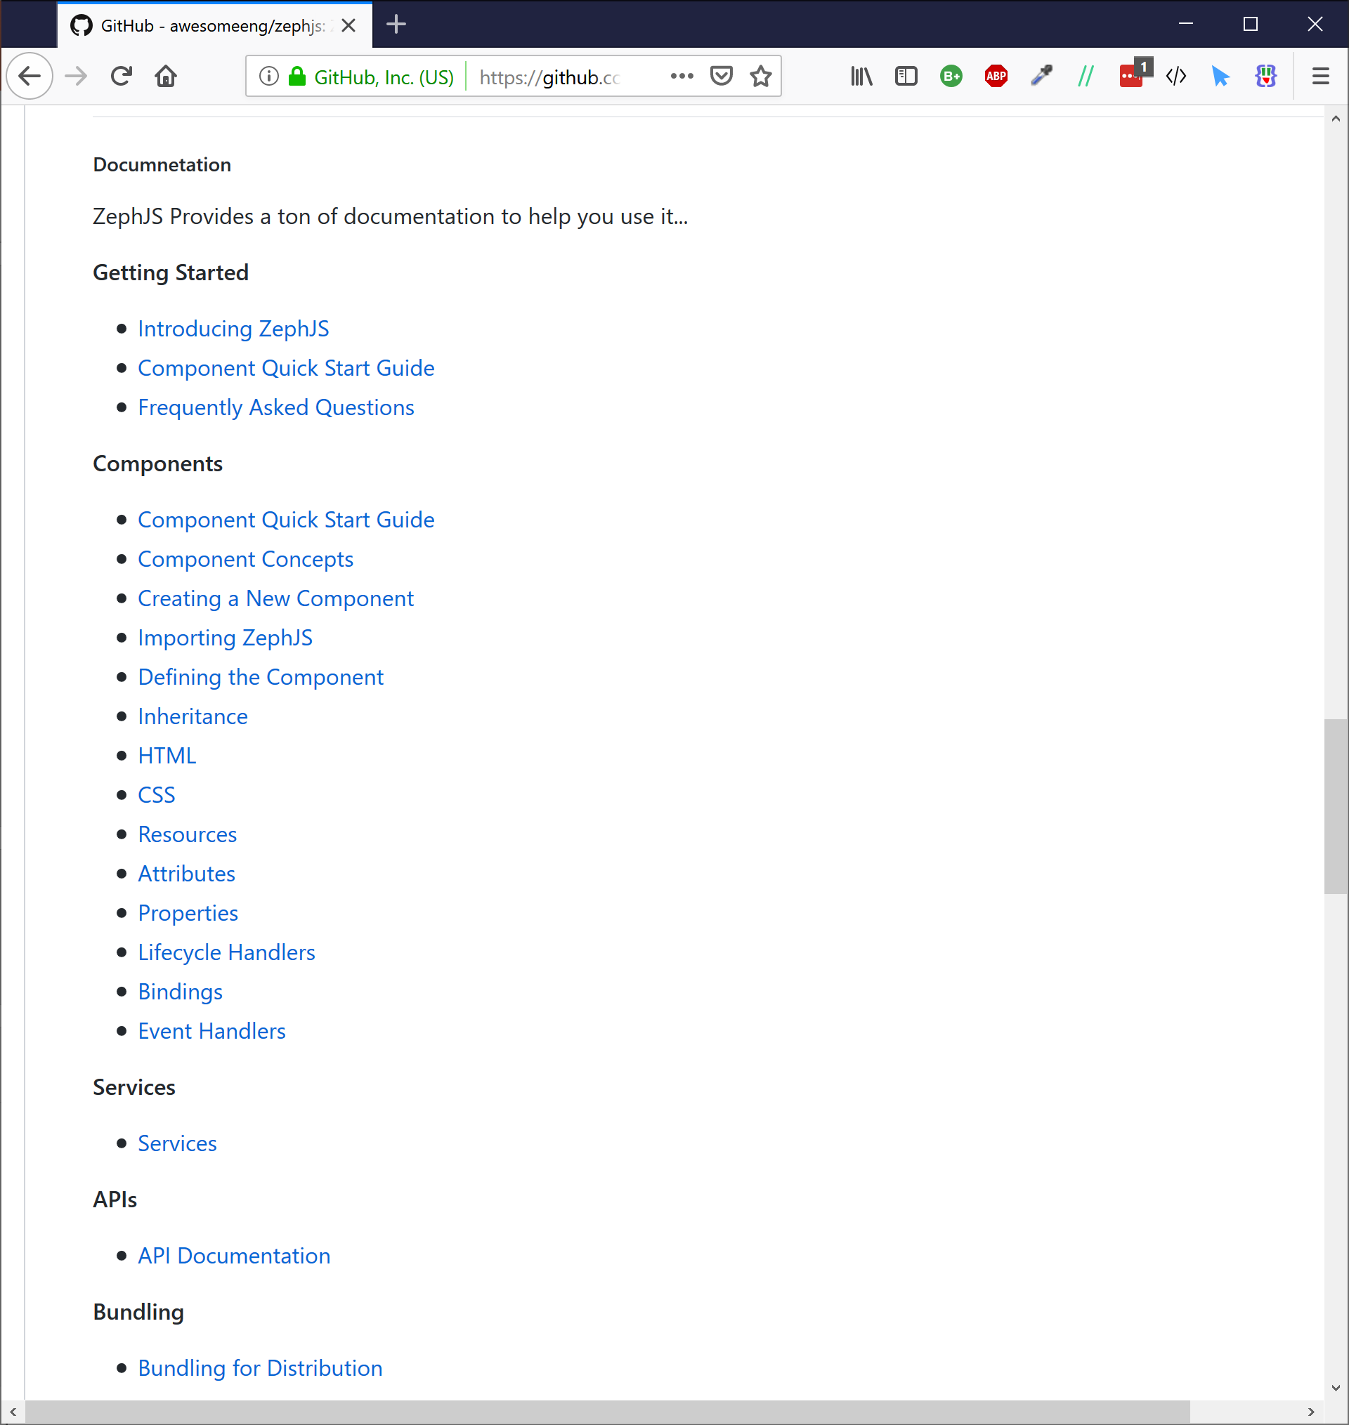
Notes:
There are a few other definition methods
and some really neat things you can do like
handling lifecycle events
or inheriting from another ZephJS component.
Everything is carefully enumerated
in the documentation.
So a quick read is encouraged.

Slide 33
./my-widget.js
ZephComponents.define(“my-widget”,()=>{
… definition methods …
});
ZephJS
Component
Context
Component
Class
./index.html
…
<my-widget>
</my-widget>
…
Custom Elements
Registry
Notes:
Once you have defined your component,
ZephJS executes the definition function
and builds what is called a Component Context,
which describes the component completely.
It then registers the given name
with the Custom Elements API
using a custom Component Class
that when instantiated
uses the Component Context
that was generated
to setup the component.
That sounds really complicated,
so lets just say some magic happens

Slide 34
./my-widget.js
ZephComponents.define(“my-widget”,()=>{
… definition methods …
});
MAGIC!
ZephJS
Component
Context
Component
Class
./index.html
…
<my-widget>
</my-widget>
…
Custom Elements
Registry
Notes:
and ZephJS turns your name and definition
into a registered custom element
and you are good to go.
Alright, that's all the slides, lets get into it and build something...

Slide 35

Notes:
For our very contrived example,
let us build a Star Rating component.
You know the type of thing like on netflix.
Where you click on a star
that's how much you like
that movie or tv show or whatever.

Slide 36
LIVE CODING
Notes:
So let's get at it...
[SWITCH TO IDE HERE]
[DO NOT GO TO NEXT SLIDE]

Slide 37

ZephJS
npm repo zephjs
github.com/awesomeeng/zephjs
Fun Fact: This is Zephyr our kitten, for whom ZephJS is named. Hi Zephyr!
Notes:
So that is ZephJS.
I hope you all find it
as easy to use and read
as I do.
There is a ton of documentation
available on github
I encourage you to
check it out
and start using ZephJS
for all your component needs.
Also,
I do have one last request
of everyone here
before we go drink beer...

Slide 38



Try
Star
Tweet
Notes:
Please give ZephJS a try.
Please give us some github stars.
And please help spread the word
by tweeting and retweeting about ZephJS.
I am super excited about it
and I really want to see it
and the community around it grow.
In fact, if you come to the bar
and find me
and promise me
you are going to try,
and star,
and tweet
about ZephJS

Slide 39
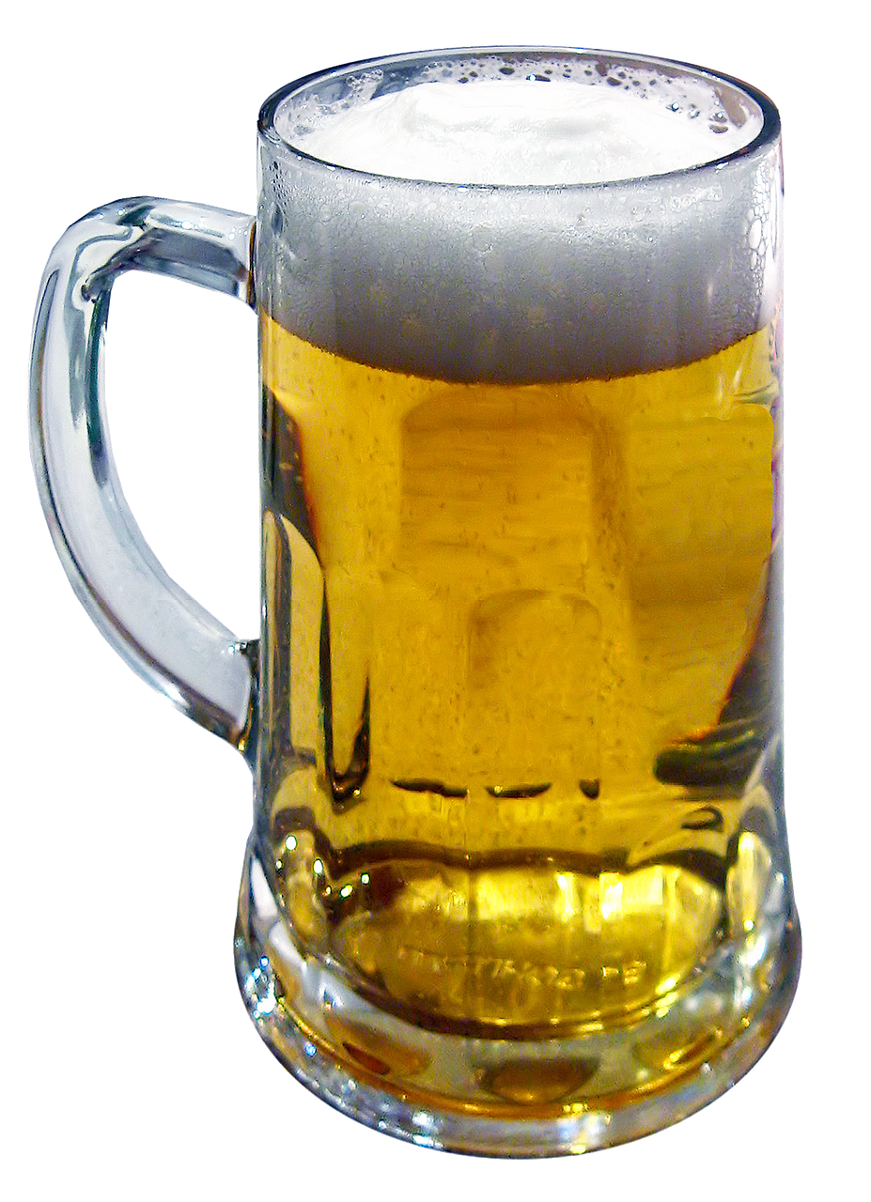
Still not a picture of Shane buying you Free Beer
Notes:
I will make Shane buy you a beer.
Thanks Shane!
You’re alright.

Slide 40
ZephJS
npm repo zephjs
github.com/awesomeeng/zephjs
Glen R. Goodwin
Awesome Engineering
Notes:
Thank you everyone.

